Slide 1
RELEVANT CRIMINAL LAWS AND HOW TO WIN
THE THIESSEN LAW FIRM
Mark Ryan Thiessen
914 Waters
Aspen, Colorado 81611
(970) 465-9120
Cell (832) 654-3058
mark@thecoloradotrialattorney.com
Pitkin County Bar Association
December 18, 2025

Slide 2
1.
GET ALL
THE VIDEOS

Slide 3
1. GET ALL THE VIDEOS
CRS § 24-31-902 (I) (July 21, 2023)
ENHANCE LAW ENFORCEMENT INTEGRITY ACT
(II) (A) …a peace officer shall wear and activate a body-worn camera or dash camera, if the peace officer's vehicle is equipped with a dash camera, when responding to a call for service, entering into a premises for the purposes of enforcing the law or in response to a call for service, during a welfare check except for a motorist assist, or during any interaction with the public initiated by the peace officer, whether consensual or nonconsensual, for the purpose of enforcing the law or investigating possible violations of the law. The body-worn camera or dash camera does not need to be on when en route to a call for service, but should be turned on shortly before the vehicle approaches the scene.
(B) A peace officer may turn off a body-worn camera to avoid recording personal information that is not case related; when working on an unrelated assignment; when there is a long break in the incident; and in administrative, tactical, and management discussions when civilians are not present.

Slide 4
1. GET ALL THE VIDEOS
(III) If a peace officer fails to activate a body-worn camera or dash camera as required by this section or tampers with body-worn- or dash-camera footage or operation when required to activate the camera, there is a permissive inference in any investigation or legal proceeding, excluding criminal proceedings against the peace officer, that the missing footage would have reflected misconduct by the peace officer. If a peace officer fails to activate or reactivate his or her body-worn camera as required by this section or tampers with body-worn- or dash-camera footage or operation when required to activate the camera, any statements or conduct sought to be introduced in a prosecution through the peace officer related to the incident that were not recorded due to the peace officer's failure to activate or reactivate the body-worn camera as required by this section or if the statement or conduct was not recorded by other means creates a rebuttable presumption of inadmissibility.

Slide 5
1. GET ALL THE VIDEOS
Colorado Rules of Criminal Procedure16
(a) Prosecutor's Obligations.
(1) The prosecuting attorney shall make available to the defense the following material and information which is within the possession or control of the prosecuting attorney, and shall provide duplicates upon request, and concerning the pending case:
(I) Police, arrest and crime or offense reports, including statements of all witnesses;
(IV) Any books, papers, documents, photographs or tangible objects held as evidence in connection with the case;
(VI) All tapes and transcripts of any electronic surveillance (including wiretaps) of conversations involving the accused, any codefendant or witness in the case;
(VIII) Any written or recorded statements of the accused or of a codefendant, and the substance of any oral statements made to the police or prosecution by the accused or by a codefendant, if the trial is to be a joint one.

Slide 6
2.
5ng
Of
Delta-9 THC

Slide 7
2. >5ng of Delta-9 THC
CRS § 42-4-1301 (6)(a)(IV)
House Bill 13-1325 (May 28, 2013)
(IV) If at such time the driver's blood contained five nanograms or more of delta 9-tetrahydrocannabinol per milliliter in whole blood, as shown by analysis of the defendant's blood, such fact gives rise to a permissible inference that the defendant was under the influence of one or more drugs.

Slide 8
2. >5ng of Delta-9 THC
PRESUMED v PRESUMPTIVE INFERENCE (6)(a)(I-IV)
(a) …..DUI or DWAI, the defendant's BAC or drug content at the time of the commission of the alleged offense or within a reasonable time thereafter gives rise to the following presumptions or inferences:
(I) If at such time the defendant's BAC was 0.05 or less, it shall be presumed that the defendant was not under the influence of alcohol and that the defendant's ability to operate a motor vehicle or vehicle was not impaired by the consumption of alcohol.
(II) If at such time the defendant's BAC was in excess of 0.05 but less than 0.08, such fact gives rise to the permissible inference that the defendant's ability to operate a motor vehicle or vehicle was impaired by the consumption of alcohol, and such fact may also be considered with other competent evidence in determining whether or not the defendant was under the influence of alcohol.
(III) If at such time the defendant's BAC was 0.08 or more, such fact gives rise to the permissible inference that the defendant was under the influence of alcohol.
(IV) If at such time the driver's blood contained five nanograms

Slide 9
2. CDOT 2025 Report
Colorado Department of Public Health and Environment. (Jan. 2025). Postmortem toxicological presence of marijuana among Colorado residents younger than 25 years.
“Receiving a THC positive test result does not equal THC intoxication at time of death due to the timing of THC metabolism and how this differs between individuals and acute versus chronic use patterns.”

Slide 10
2. CDOT 2025 Report
“Presence of cannabinoids indicates past cannabis exposure, but information that is more detailed, such as frequency of use, proximity of use to death, or if the person was intoxicated at time of death, is not known at this time.
Prior to death, cannabinoid metabolism can vary based on an individual’s body composition, cannabis use method, and length of time using cannabis.”

Slide 11
2. 2nd CDOT 2025 Report
Monitoring Health Effects Related to Marijuana in Colorado: 2024 (February 20, 2025)
“High THC concentration marijuana use by adolescents and young adults is associated with continued marijuana use.”

Slide 12
2. 5ng Bottom Line
THC Metabolizes Different than Alcohol
THC Lasts Longer In the Body
Mere Presence Is NOT Psychoactive
No SFSTS Validating for MJ
What do they look like?

Slide 13
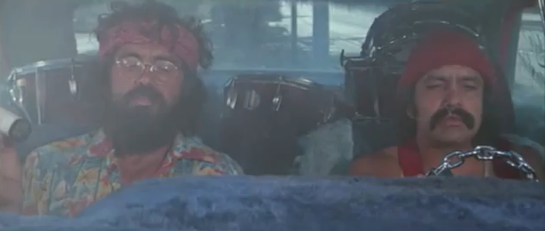
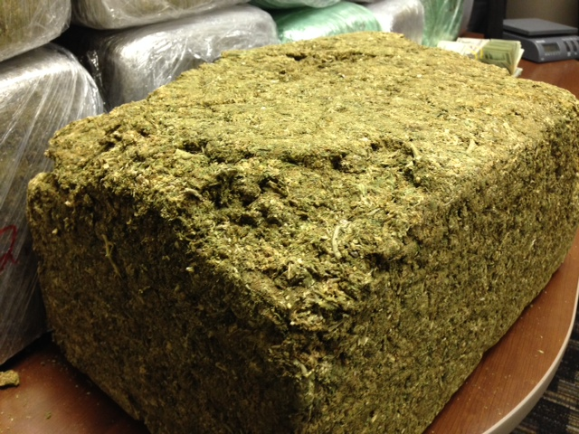

Slide 14
3.
PBT
IS INADMISSIBLE

Slide 15
3. PBT NOT ADMISSIBLE
CRS § 42-4-1301 (6)(i)(III)
Cain v. People, 2014 CO 49 (2014)
(III) Neither the results of such preliminary screening test nor the fact that the person refused such test shall be used in any court action except in a hearing outside of the presence of a jury, when such hearing is held to determine if a law enforcement officer had probable cause to believe that the driver committed a violation of this section. The results of such preliminary screening test shall be made available to the driver or the driver's attorney on request.

Slide 16
4.
REFUSE
THE BREATH TEST?

Slide 17
4. DO NOT BLOW in CO
#1: Better Chance at Trial
Refuse to Blow:
7 Days to Request a DMV Hearing - Stayed
Used Against You in Trial?
Minor (under 21) no driving 1 year
No Additional Revocation
Adults –
1 year drivers license suspension
Restore after 2 months with Interlock
Restricted License - Interlock for Up to 2 years
Persistent Drunk Driver Designation(>.15, refusal, or multiple DUI convictions)
Class - Level II Alcohol and Drug Education and Treatment program.
SR-22 Insurance

Slide 18
4. CONVICTED OF DUI..
JAIL: DWAI (2-180) DUI (5-365) 2nd (10-365) 3rd (60-365) 4th (90-180prob, 2-6yrs)
FINES: 200-1500; 2k-500k
COMMUNITY SERVICE: 24; 48-120
TREATMENT: 1st <.15 (66h,8m) >.15 and refusal (76h, 9m). 2nd<.15 (92h,11m) 2nd >.15 and refusal (110h,13m)
DL SUSPENSION: DWAI (none); 1st (9m w 8m GI); 2nd (1 y w 2-5y GI); 3rd (2y w 2-5y GI)
CLASSES
MEETING w/ PROBATION
RANDOM TESTING
COLLATERAL CONSEQUENCES

Slide 19
4. AFTER DMV HEARING
REFUSAL: https://dmv.colorado.gov/reinstatement-frequently-asked-questions#:~:text=*%20Complete%20an%20Application%20for%20Reinstatement%20(Form,II%20Alcohol%20or%20Drug%20Education%20and%20Treatment.
1st DUI: 1y suspension/ 60d hard/ 2y Interlock/ SR-22 1y (3y if acc)/ Level II Alcohol or Drug Education and Treatment
2nd DUI: 2y susp/ 60d hard/ 2y Interlock/ SR-22 3y/ Level II
3rd DUI: 3y susp/ 60d hard/ 2y Interlock/ SR-22 3y/ Level II

Slide 20
4. AFTER DMV HEARING
FAILURE:
1st DUI over .08: 9m suspension/ Interlock Immediately/ 4 months no violation unrestricted/ SR-22 9m (3y if acc)
1st DUI over .15: 9m suspension/ Interlock Immediately/ Interlock 2y/ SR-22 3y/ Level II
2nd DUI: 1y susp/ Interlock Immediately/ Interlock 2y/ SR-22 3y/ Level II
3rd DUI: 2y susp/ Interlock Immediately/ Interlock 2y/ SR-22 3y/ Level II

Slide 21
4. AFTER DUI CONVICTION
1st DUI: 9month suspension/ Interlock for 8 months/ SR-22 3 years
2nd DUI within 5 years: 1 year suspension/ Interlock for 2 years/ SR-22 3 years/ Level II Alcohol or Drug Education and Testing
3rd DUI over lifetime: 2 year suspension/ Interlock for 2 years/ SR-22 3 years/ Level II

Slide 22
4. BLOOD WARRANT?
People v Raider, 2022 CO 40 (Colo. 2022)
Some Counties
Required Unless SBI or Death
Judge or On-Call Magistrate
Sworn Affidavit
Reasonable Suspicion for Stop
Probable Cause of DUI or DWAI
Alcohol or Other Drugs
Time Sensitive
Refusal

Slide 23
5. BREATH TEST
ONLY TESTS FOR ALCOHOL

Slide 24
6. HIRE DAVID KEECH
www.bristineservices.com
970-462-7610

Slide 25
7.
GUNS
IN COLORADO

Slide 26
7. GUNS IN COLORADO
CAN NOT IF INTOXICATED OR UNDER THE INFLUENCE
OPEN CARRY
Over 18
Not in Denver County
Places Can Prohibit It
CONCEALED CARRY
Need a Concealed Carry Weapon (CCW) permit or Concealed Handgun Permit (CHP)
Out of State – Reciprocity (Texas:yes)

Slide 27
8.
NO MIRANDA?!

Slide 28
9.
GO
TO
TRIAL!

Slide 29
9. GO TO TRIAL!
Better Deals
Better Deals in the Future
Never Know What a Jury Will Do
Should Never Be a Trial Tax

Slide 30
TRIAL STATISTICS
“There is a joke among lawyers about the difference between jury trials in England and the United States: in England, the trial starts once the jury selection ends; in America, the trial is already over.” - https://www.nytimes.com/1994/11/29/science/study-finds-jurors-often-hear-evidence-with-closed-minds.html
“About 80-90 percent of jurors make up their minds about how they are going to vote at the conclusion of opening statements.”
- Opening Statement: Setting the Tone for Trial (2019). Advocate Magazine. https://www.advocatemagazine.com/article/2019-january/opening-statement-setting-the-tone-for-trial

Slide 31
TRIAL STATISTICS
“These jurors decide on a version of events based on a preliminary story they find convincing, often at the time of the opening arguments, which then colors their interpretation of the evidence so much that they seize on whatever fits their verdict and discount the rest.” - NYT

Slide 32
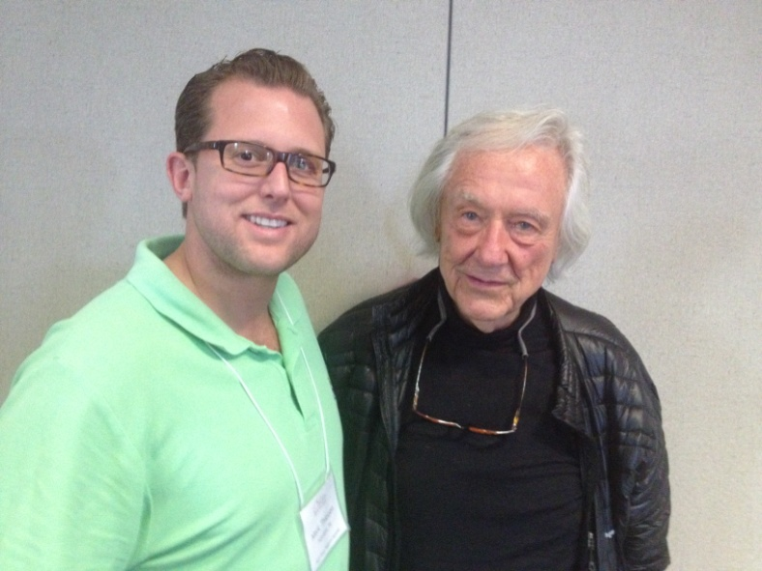
VOIR DIRE
Where you WIN your case
Be REAL, Be YOU
Show Them Yours
Use Creative Examples for Tough Facts

Slide 33
ICEBREAKERS
1 Promise
Know All About You/ Know Same About Me
Best/Worst Thing In My Life
Gerry Spence – Feel The Room
Be You/ Be Real/ Be Authentic

Slide 34
10.
TRIAL
TECHNIQUES
THAT WORK

Slide 35
DRINKING PATTERNS
1. REGULARLY
2. OCCASIONALLY
3. RARELY
4. NEVER
5. NOT ANY MORE

Slide 36

HOW DO YOU FEEL ABOUT POLICE LABS?
TERRIBLE GREAT

Slide 37
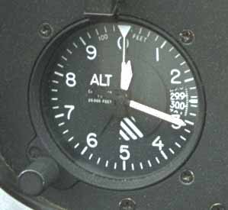
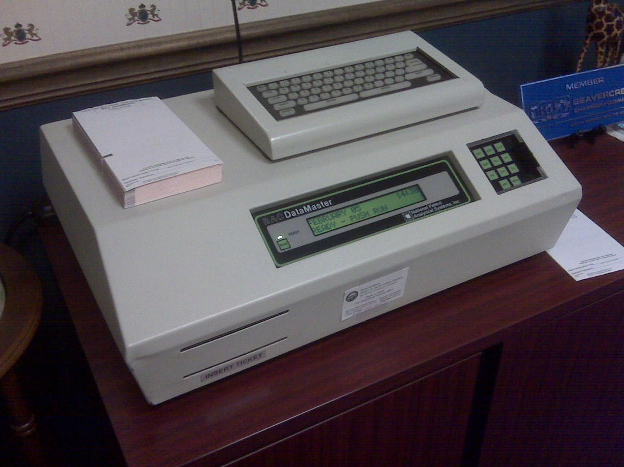
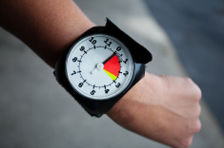
BREATH TESTING
Taxalyzer/ Altimeter

Slide 38
BLOOD TESTING
Tactic 1: Stop Watch
Tactic 2: Health Problems
Tactic 3: Scientists and Computers
Tactic 4: EPT Test
Tactic 5: Pure Disconnect
Tactic 6: Thermometer

Slide 39

PRESUMPTION OF INNOCENCE
INNOCENT GUILTY

Slide 40
ASSUME
v.
PRESUME

Slide 41


PRESUMPTION OF INNOCENCE

Slide 42

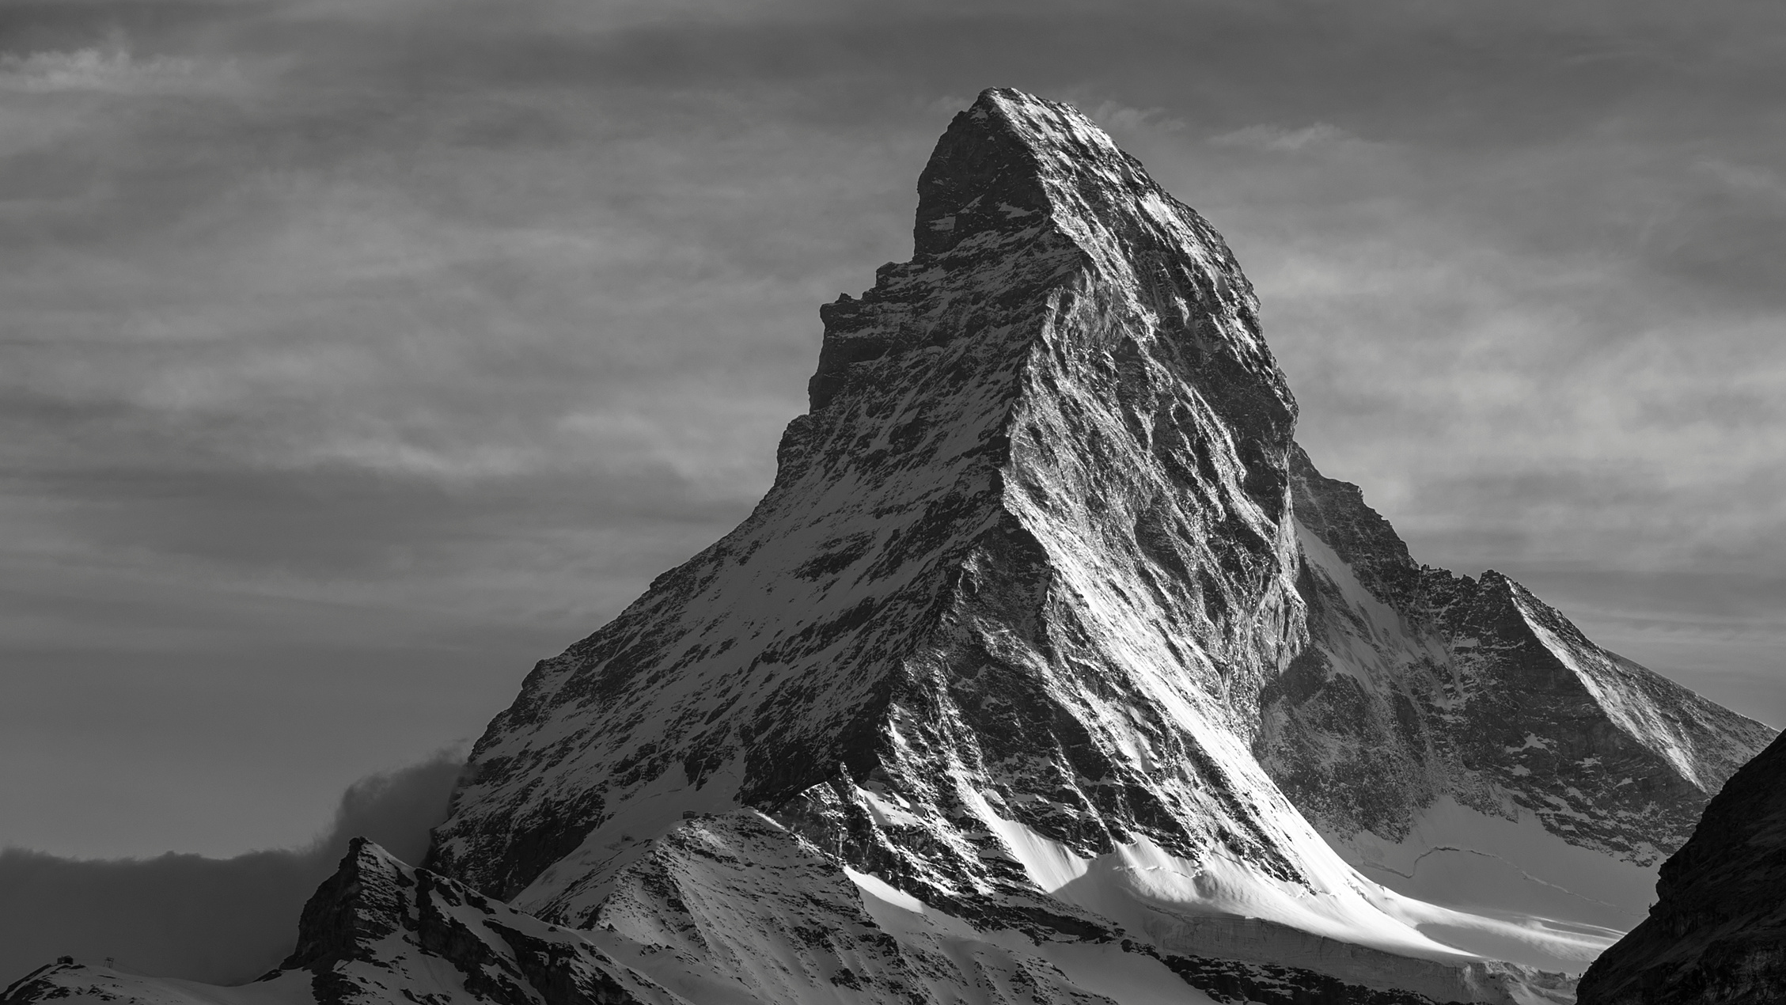




BEYOND A REASONABLE DOUBT
A Reasonable
Doubt
BURDENS OF PROOF
CLEAR AND CONVINCING
PREPONDERANCE
PROBABLE CAUSE
REASONABLE SUSPICION
SCINTILLA
NO EVIDENCE
Notes:
Next, is reasonable suspicion. This part of the mountain trek is the part the kids can make it to. You have started to make the hike, but you really haven't made it that far. It's still not too late to turn around...
In legal sense, we look at this as what an officer has to stop someone. If you are walking down the street in the middle of Texas summer with a ski mask and a trench coat, that's reasonable suspicion to stop you. However, if it is the Texas winter like we have been experiencing, its a little more justified.

Slide 43
BEYOND A REASONABLE DOUBT
BURDENS
OF
PROOF
PREPONDERANCE OF EVIDENCE
NO EVIDENCE
Notes:
Next, is reasonable suspicion. This part of the mountain trek is the part the kids can make it to. You have started to make the hike, but you really haven't made it that far. It's still not too late to turn around...
In legal sense, we look at this as what an officer has to stop someone. If you are walking down the street in the middle of Texas summer with a ski mask and a trench coat, that's reasonable suspicion to stop you. However, if it is the Texas winter like we have been experiencing, its a little more justified.

Slide 44
BEYOND
A
REASONABLE
DOUBT

Slide 45
ONLY GUILTY IF UNANIMOUS & BEYOND A REASONABLE DOUBT

Slide 46
11 NOT GUILTY
1 GUILTY

Slide 47
6 NOT GUILTY
6 GUILTY

Slide 48
1 NOT GUILTY
11 GUILTY

Slide 49
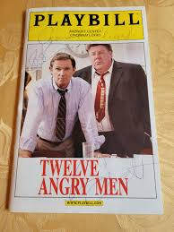
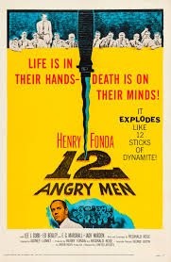
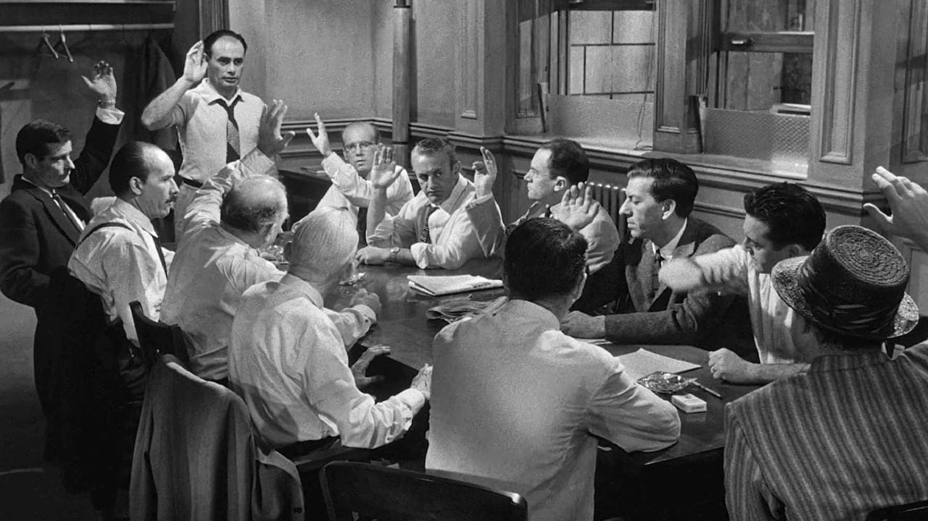

Slide 50
1 NOT GUILTY
11 GUILTY

Slide 51
ONLY GUILTY IF UNANIMOUS & BEYOND A REASONABLE DOUBT

Slide 52
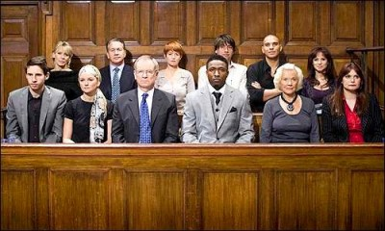
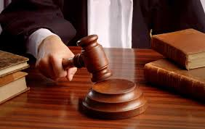
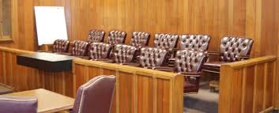
JURY SERVICE

Slide 53

QUESTIONS??? mark@thecoloradotrialattorney.com cell: (832) 654-3058

